Slide 1
PokeRL
MDST WN2021 Project

Slide 2
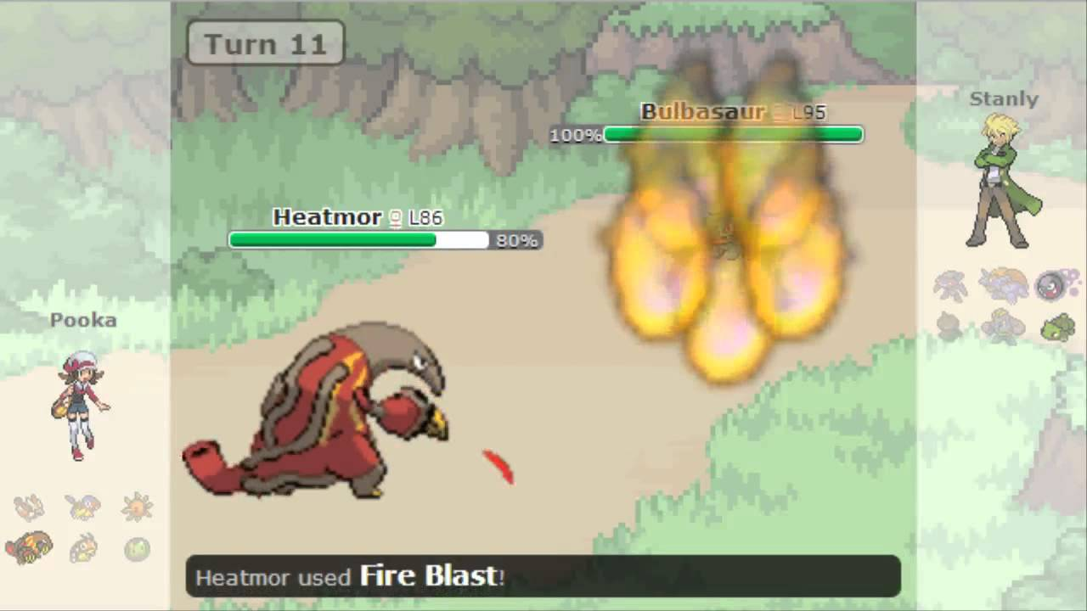
Background: Pokemon
Pokemon is a turn based video game where players send out their Pokemon to battle against the opponents Pokemon one at a time. More generally, it is a 2-player turn based game where each player does not know all the information about their opponent
Our project attempts to find an optimal battle strategy for the game utilizing heuristics and reinforcement learning
We used Pokemon Showdown to simulate out battles

Slide 3
Control Group: Greedy Bot
The Greedy Bot was a bot which greedily chose the highest damage move based on typing and move base power
Many groups used it as a baseline to evaluate their bots

Slide 4

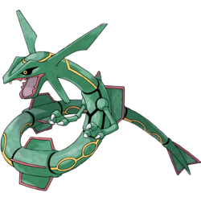
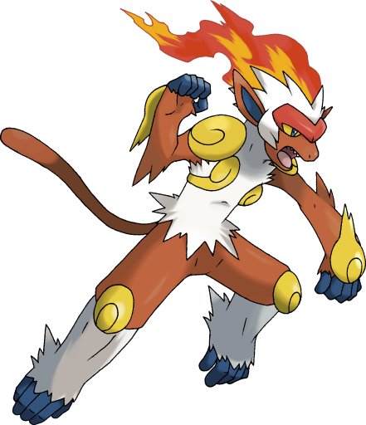

Team VIRN - Heuristic-Based Pokemon Bot
Main Strategy: Based on opponent’s active Pokemon, calculate the most damaging move available among entire party.
If our active Pokemon has best move -> attack
If move is super-effective, try to Dynamax
If a Pokemon on bench has best move -> switch to that Pokemon
Best Move determined by:
Move damage
Type relations
STAB (Same-Type Attack Bonus)
Weather effects
Overall Win Rate: 75% vs Default Greedy Algorithm Bot

Slide 5
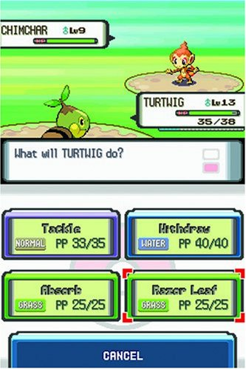
Team Solo Pokemon
How logic works
Choose the best move without switching/dynamax
Switching
Dynamax
moves

Slide 6
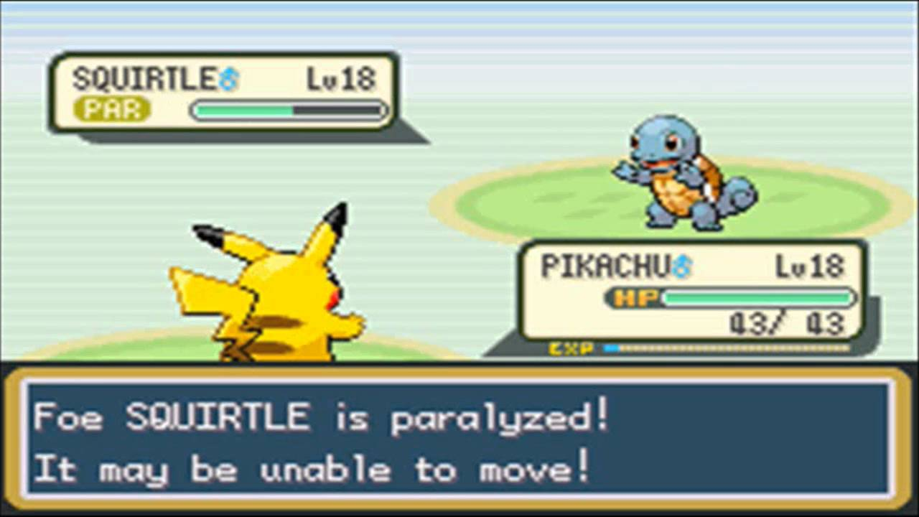
Team Solo Pokemon
Best move is determined by
move damage, types
Accuracy
secondary status (toxic, sleep, etc.)
Switching is determined by
type advantages/disadvantages
One or Two turn kill probability
base_speed of opponent and active pokemon
Type advantages/disadvantages
basic attack - (defense + current hp) or basic special attack - (special defense + current hp)

Slide 7
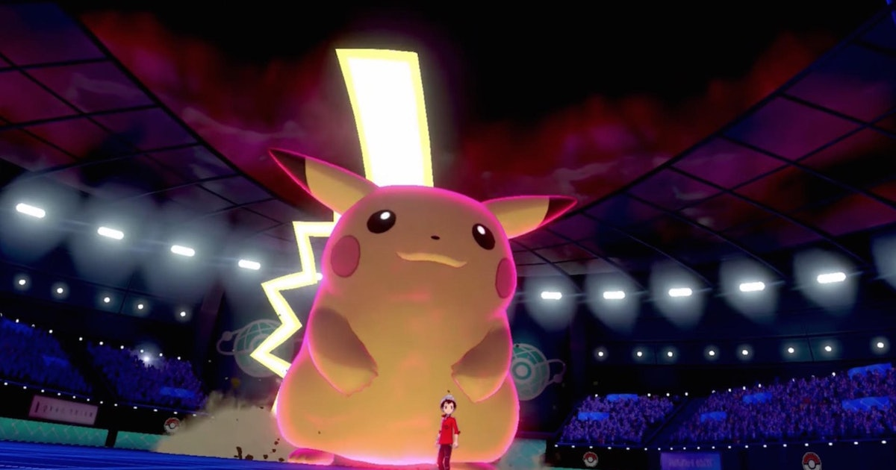
Team Solo Pokemon
Dynamax determined by
alive pokemon in the team
basic stats of the active pokemon
Types advantage/disadvantage
Outcome
75% win rate against test Greedy bot

Slide 8
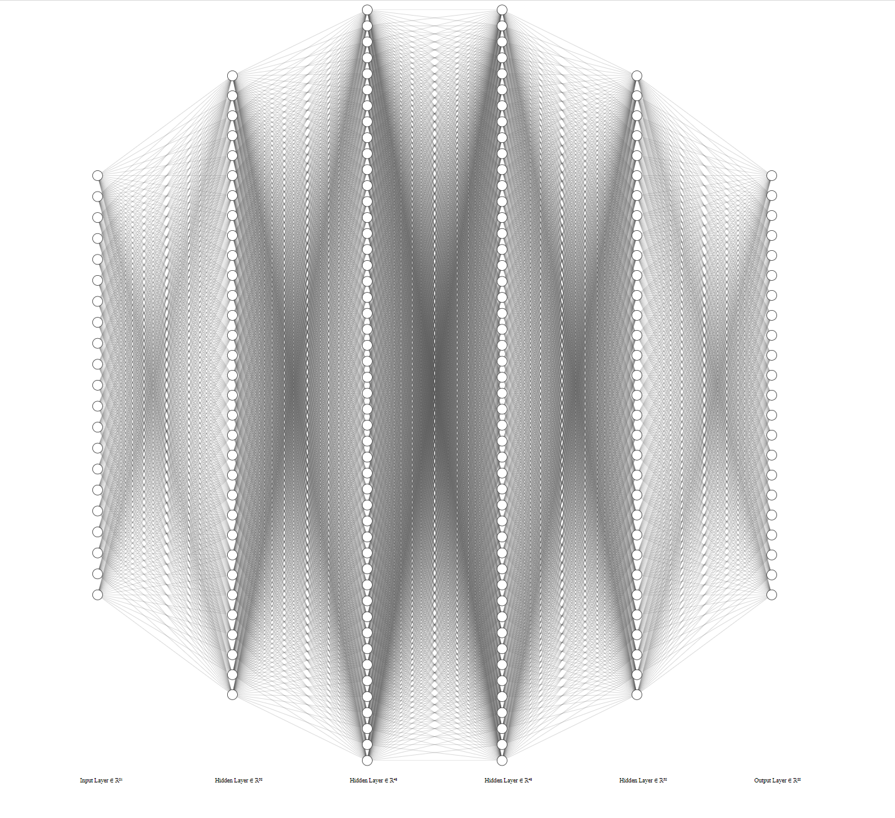
Team Elite4
Reinforcement Learning
Determining State Vector
Our + Opponents Type
Move Damage & Multiplier
Status
Dynamax
Computing Reward
Fainted = 1, HP = 5, Victory = 30
Other Factors
Learning Rate, Shape
NN (21-32-48-48-32-22), 6,934 weights
~65% Win rate vs Greedy

Slide 9
Team Elite4 con’t
Training procedure - Inspired by AlphaGo
Pre-training
Train against Greedy bot until win rate of 55-60%
Self play
Train against itself for thousands of games
Evaluation
Play against original model 400 games, if wins at least 55% save as new model, else: discard and start over at Self play
After ~15 hours, improved on itself twice
This “improved” model beats greedy ~65%
Closing thoughts
Trained on personal pc’s and Google Colab. Tried GPU training, but Colab has been unreliable
Self Play training worked but extremely time consuming and computationally intensive
NN architecture was very simple, more sophisticated architecture may be needed

Slide 10
Results
Best of 3 (Best of 1000)
Team Solo Pokemon 1 - 2 Elite 4 (596 - 404)
Elite 4 2 - 1 Team Virn (344 - 656)
Team Solo Pokemon 1 - 2 Team Virn (451 - 549)
Want to battle against any of these bots? Contact Neel on Slack

